Slide 1
Final Presentation
Evolution of Job Market Trends: Analyzing the Past Decade
Group 4
Anne Ha (013680615), Devesh Singh(017462718), Jiyoon Lee (011987027) , Mayuka Kothuru (017609436), Najel Alarcon(018174299)

Slide 2
Problem Understanding and Formulation
The U.S. job market has changed significantly in the past decade
Economic, technological, and workforce shifts are the main drivers of change
These changes affect job roles, required skills, and employment models
Understanding these trends is key to predicting future job market patterns
Notes:
The employment landscape in the U.S. has dramatically changed within the last ten years due to combined economic, technological, and dynamic workforce pressures. These drivers have redefined job roles, skill needs, and employment models that are at once a mix of opportunity and challenge. The understanding of these pressures is important to discern current trends and predict future employment patterns; however, such factors creating these changes are multifaceted and intertwined.

Slide 3
Objective & Scope
Objective
Scope
Provide a comprehensive analysis of the U.S. job market over the past 10 years
Understand the impacts of
Economic shifts
Technological advancements
Workforce preferences
Workforce demographics
Growing industry demands
Offer insights into future employment trends and opportunities
Focus on industries such as
Management, Business, Science and Arts
Natural Resources, Construction & Maintenance
Production, Transportation & Material moving
Sales & Office
Service
Analyze employment growth and shifts in demand across the various industries

Slide 4
Data Collection & Exploration
Collected from US Data
Provides data on employment, demographics, education, healthcare and etc
Aggregates data from trusted U.S. government agencies:
U.S. Census Bureau, Bureau of Labor Statistics and Federal Reserve
Data accessibility: Free and open access to a wide range of datasets
Regularly updated; with quarterly and annual updates

Slide 5
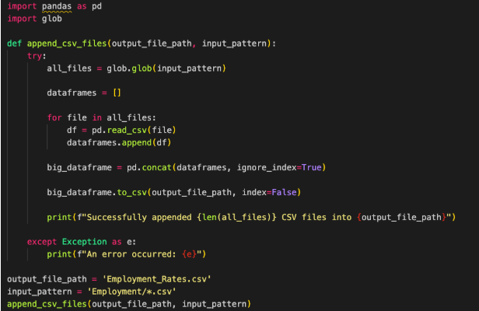
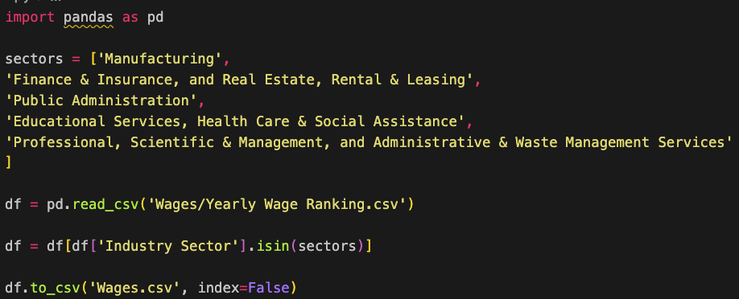
Data Processing
The source data was almost cleaned so the focus was on integration using Python

Slide 6
State and Unemployment Rate

Slide 7
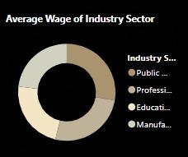
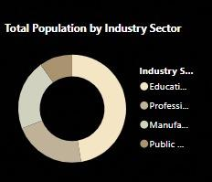

Slide 8
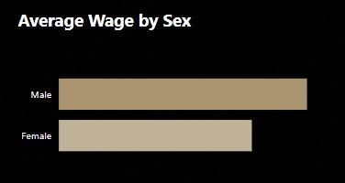
The graph shows that males have a higher average wage compared to females.
The bar lengths indicate a visible wage gap, highlighting gender-based disparities in earnings.

Slide 9
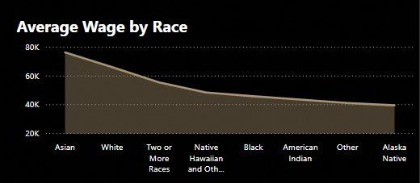

Slide 10
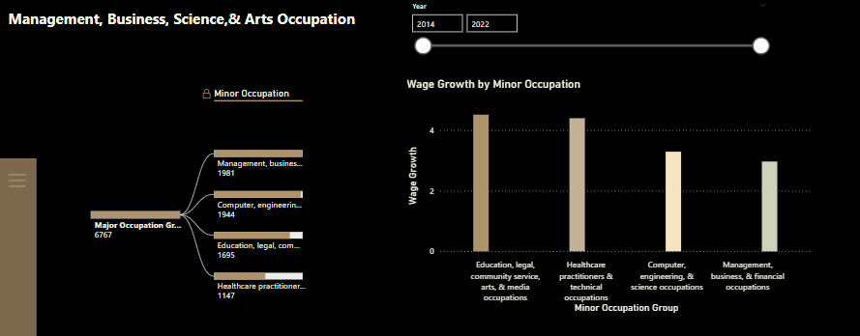
Management, Business, Science & Art

Slide 11
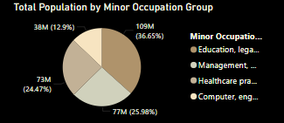
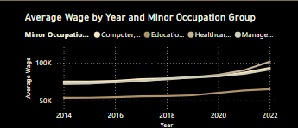
Management, Business, Science & Art

Slide 12
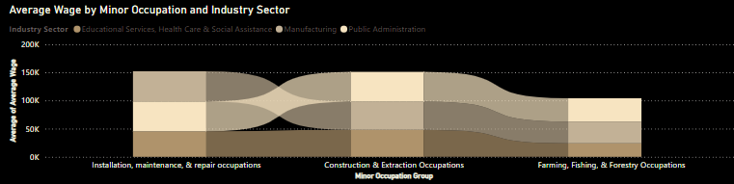
Natural resources, Construction & Maintenance

Slide 13
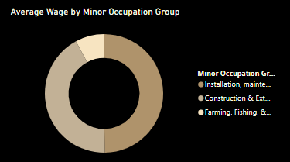
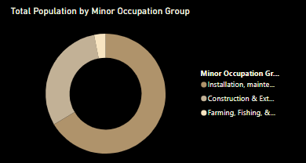
Natural resources, Construction & Maintenance

Slide 14
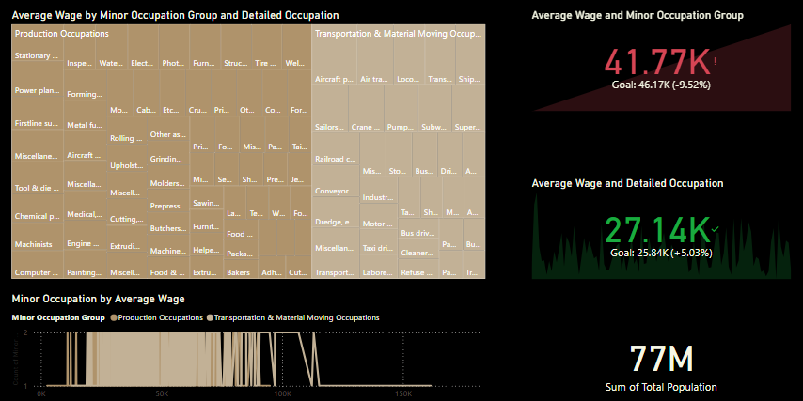
Production & Transportation

Slide 15
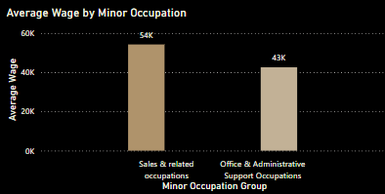
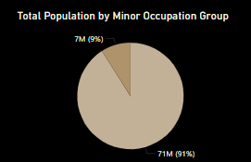
Sales & Office

Slide 16
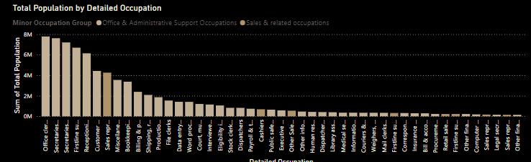
Sales & Office

Slide 17
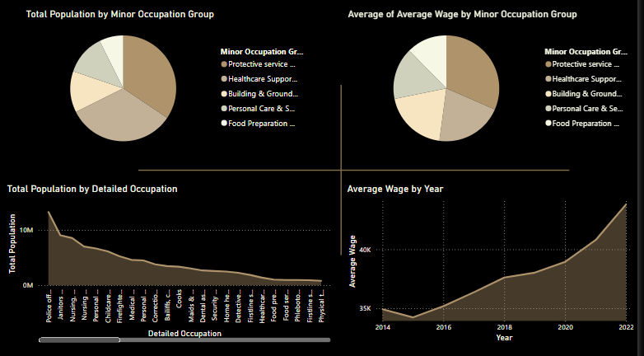
Service
Notes:
Population Distribution: largest workforce out of the 109M population is contributed by Protective Services

Slide 18
Overall Key Trends

Slide 19
Future Look
Predictive Models: Use machine learning to predict trends in skills, salaries to anticipate emerging challenges
Real-Time Data: Integrate data from platforms such as LinkedIn and Glassdoor etc to take actionable insights at the right time
Demographic Analysis: Analyze trends in gender, race, and age to address equity to encourage workforce diversity and inclusion.
Emerging Technologies: Assess AI, blockchain, and automation impacts. To generate future-proof workforce insights.
Policy Recommendations: Propose ways to address skill gaps and lifelong learning to create a resilient and adaptable workforce.

Slide 20
Q&A

